Slide 1
Capital Punishment
College of the Desert
September 23, 2020
Elizabeth Waddell Bellamy, JD and
Judge Page Bellamy

Slide 2
Objectives
SEPT. 23: DEATH SYSTEMS: MORTALITY AND SOCIETY (CHAPTER 4)
OBJECTIVES
1. To identify the components and impact of the death system.
2. To identify and explain the cultural standards by which homicidal acts are judged.
3. To define homicide and distinguish various categories and types.
4. To evaluate the effects of capital punishment.
5. To develop an alternative model for punishment.
6. To identify policies and practices that promote social justice.
Greetings and Review
THE DEATH SYSTEM AND CRIMINAL JUSTICE
be prepared to discuss the following 4 items:
1. Identify the arguments for and against capital punishment.
2. Explain how differential punishments for homicide may be based on the relationship of the killer to the victim.
3. List the pros and cons of capital punishment as you see them and assess your ideas.
4. Are there alternatives? What are they?
Notes:
SEPT.SEPT. 23: DEATH SYSTEMS: MORTALITY AND SOCIETY (CHAPTER 4)
OBJECTIVES
1. To identify the components and impact of the death system.
2. To identify and explain the cultural standards by which homicidal acts are judged.
3. To define homicide and distinguish various categories and types.
4. To evaluate the effects of capital punishment.
5. To develop an alternative model for punishment.
6. To identify policies and practices that promote social justice.
Greetings and Review
THE DEATH SYSTEM AND CRIMINAL JUSTICE
be prepared to discuss the following 4 items:
1. Identify the arguments for and against capital punishment.
2. Explain how differential punishments for homicide may be based on the relationship of the killer to the victim.
3. List the pros and cons of capital punishment as you see them and assess your ideas.
4. Are there alternatives? What are they?
23: DEATH SYSTEMS: MORTALITY AND SOCIETY (CHAPTER 4)
OBJECTIVES
1. To identify the components and impact of the death system.
2. To identify and explain the cultural standards by which homicidal acts are judged.
3. To define homicide and distinguish various categories and types.
4. To evaluate the effects of capital punishment.
5. To develop an alternative model for punishment.
6. To identify policies and practices that promote social justice.
Greetings and Review
THE DEATH SYSTEM AND CRIMINAL JUSTICE
be prepared to discuss the following 4 items:
1. Identify the arguments for and against capital punishment.
2. Explain how differential punishments for homicide may be based on the relationship of the killer to the victim.
3. List the pros and cons of capital punishment as you see them and assess your ideas.
4. Are there alternatives? What are they?

Slide 3
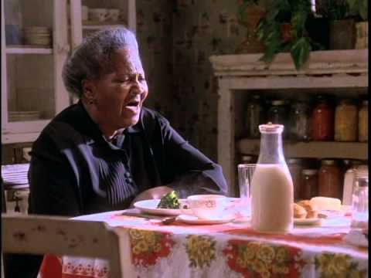
A Lesson Before Dying
video clip

Slide 4
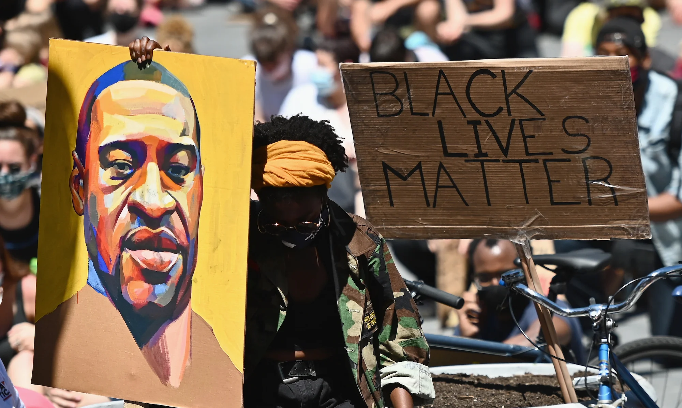
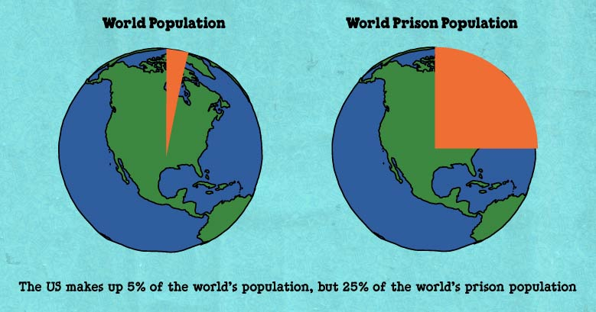
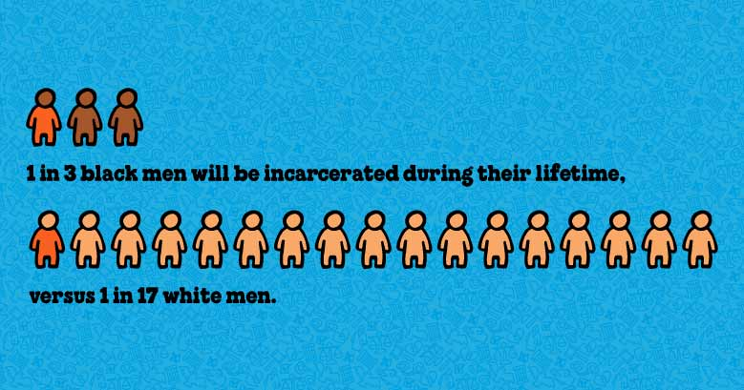
Discussion
Are the themes in the film relevant today? How so?

Slide 5
Arguments for and against DP

Slide 6
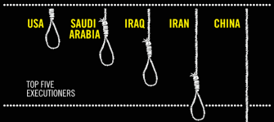

Slide 7
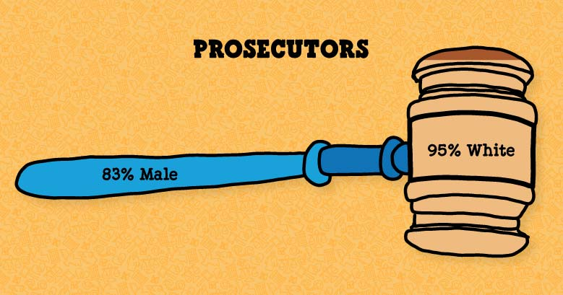

Slide 8
Killers and Crimes

Slide 9
Murder First Degree (only crime that is DP eligible)
Knowingly cause the death of another after deliberation upon the matter.
“Cool reflection for any length of time no matter how brief.”
Adam and Bill are neighbors, and lately they've been having disagreements over the fence between their properties. Adam decides to kill Bill. He gets his gun and waits for Bill in the bushes and fatally shoots him when he pulls into his driveway.

Slide 10
Murder Second Degree
Adam pays Bill a visit to discuss the fence between their properties, and while there impulsively grabs a shotgun hanging above the fireplace and shoots and kills Bill.
Adam didn't have any plan to kill Bill when he went to Bill's house that day, so there was no premeditation. At the time he pulled the trigger, however, Adam fully intended to kill Bill.
FELONY MURDER Adam and Bill go into a convenience store intending to rob it at gunpoint (which is a felony), and Adam ends up shooting the store owner, a jury could also find Bill (who didn't shoot anyone) guilty of murder, on the ground that he was involved in the original felony when the killing took place.
GEORGE FLOYD KILLER

Slide 11
Voluntary Manslaughter
Heat of passion

Slide 12
Involuntary Manslaughter

Slide 13
JUSTIFIABLE HOMICIDE
Is it a crime?

Slide 14
DP in CA
Death Penalty: Yes
Number of Executions Since 1976: 13
Number of Executions Before 1976 (may include federal and military executions): 725
Current Death Row Population: 724
Women on Death Row: 23
Number of Innocent People Freed from Death Row: 5
Number of Clemencies Granted: 0
First Execution After Reinstatement: 1992
Location of Death Row/Executions: Men: San Quentin State Prison, San Quentin, CA Women: Central California Women’s Facility, Chowchilla, CA
Murder Rate (per 100,000 population): 4.6
Is Life Without Parole an Option: Yes
Can a defendant get death for a felony in which s/he was not responsible for the murder: Yes
Method of Execution: Choice of Injection or Gas
How is Sentence Determined: Jury
Clemency Process: Governor has sole authority to grant clemency, unless inmate has a prior felony

Slide 15
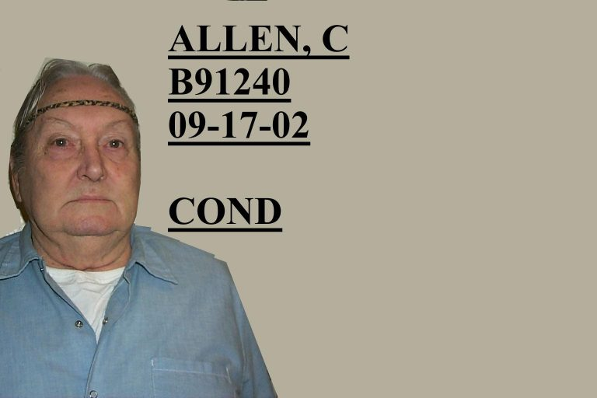
Last execution in CA was in 2006
Three counts of first-degree murder with special circumstances and one count of conspiracy
AKA “Junebug”

Slide 16
Junebug’s last meal
Buffalo steak, Kentucky Fried Chicken (all white meat), fried bread, pecan pie (sugar free), black walnut ice cream (sugar free); and whole milk

Slide 17
COVID
Coronavirus Prison Fatalities Surpass Two Decades of Executions; COVID-19 Has Killed More California Death Row Prisoners Than the State Has Executed in 27 Years

Slide 18
Death Penalty Issues and Hurdles

Slide 19
Aggravating Circumstance
Jury must find one or more statutory aggravating circumstances beyond a reasonable doubt.

Slide 20
Statutory Aggravators
There are 17 statutory aggravating
Circumstances.

Slide 21
Statutory Aggravators
1. Has prior conviction for murder in the first degree or serious assaultive conviction
2. Committed by a person in, or who has escaped from, the lawful custody of a peace officer or place of confinement
3. Committed during a crime which is part of a pattern of criminal street gang activity

Slide 22
Statutory Aggravators
4. Was engaged in the commission or attempted commission of another unlawful homicide
5. Created a great risk of death to more than one person by means of a weapon or device which would normally be hazardous to the lives of more than one person
6.Committed for the purpose of receiving any
thing of monetary value from another

Slide 23
Statutory Aggravators
7. Hired or directed another to murder or committed murder as an agent of another
8. Created a great risk of death to more than one person by means of a weapon or device which would normally be hazardous to the lives of more than one person
9. Committed for the purpose of avoiding, interfering with, or preventing arrest or custody

Slide 24
Statutory Aggravators
10. Committed while engaged in the perpetration a felony of any degree of rape, sodomy, burglary, robbery, kidnapping, or a felony drug offense
11.Victim killed as a result of the hijacking of an airplane, train, bus, etc.
12.Committed for the purpose of concealing or attempting to conceal a felony drug offense

Slide 25
Statutory Aggravators
13. Current or former judicial officer, prosecutor, peace officer, or elected official murdered during or because of exercise of official duty
14. Peace officer or fireman murdered while engaged in performance of official duty
15. Witness or potential witness in a past or pending investigation or prosecution and murdered as a result of that status

Slide 26
Statutory Aggravators
16. Employee of jail or correctional institution
killed in the course of performing his official duties or inmate of same
17. Murder was outrageously or wantonly vile, horrible or inhuman in that it involved
torture, or “depravity of mind”

Slide 27
“depravity of mind”
Inflicted physical pain or emotional suffering for the purpose of making them suffer
2. Committed repeated and excessive acts of physical abuse making the killing unreasonably brutal
3. Murdered after victim was bound or otherwise rendered helpless and thereby exhibited callous disregard for the sanctity of human life

Slide 28
“depravity of mind”
4. Murdered knowing victim was physically disabled and helpless
5. While killing or immediately thereafter purposefully mutilated or grossly disfigured the body beyond that necessary to cause death
6. While killing or immediately thereafter
sexually violated victim

Slide 29
“depravity of mind”
Murdered as part of plan to kill more than one person and thereby …
8. Sex with victim random and thereby …

Slide 30
“depravity of mind”
9. Murdered for purpose of causing suffering to another person and thereby …
10. Murdered for sole purpose of deriving pleasure from act of killing and thereby …

Slide 31
Mitigating Circumstances
No significant criminal history
Was committed while under the influence of extreme mental or emotional disturbance
Victim was a participant in defendant’s conduct
Was an accomplice and participation relatively minor

Slide 32
Mitigating Circumstances
5. Acted out of extreme duress or under
substantial domination of another
Capacity to appreciate criminality of conduct or conform conduct to requirements of law as substantially impaired
Age at time of offense

Slide 33
Must find LWOP if defendant is:
Intellectually disabled, or
Under age 18

Slide 34
Jury must find BRD:
Evidence in aggravation of punishment is not outweighed by evidence in mitigation of punishment

Slide 35
Finally,
Jury is told it is never required to return a verdict of death

Slide 36
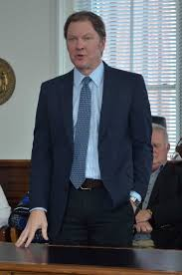
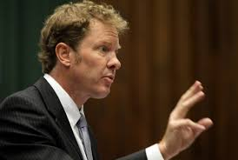
Actual cases

Slide 37
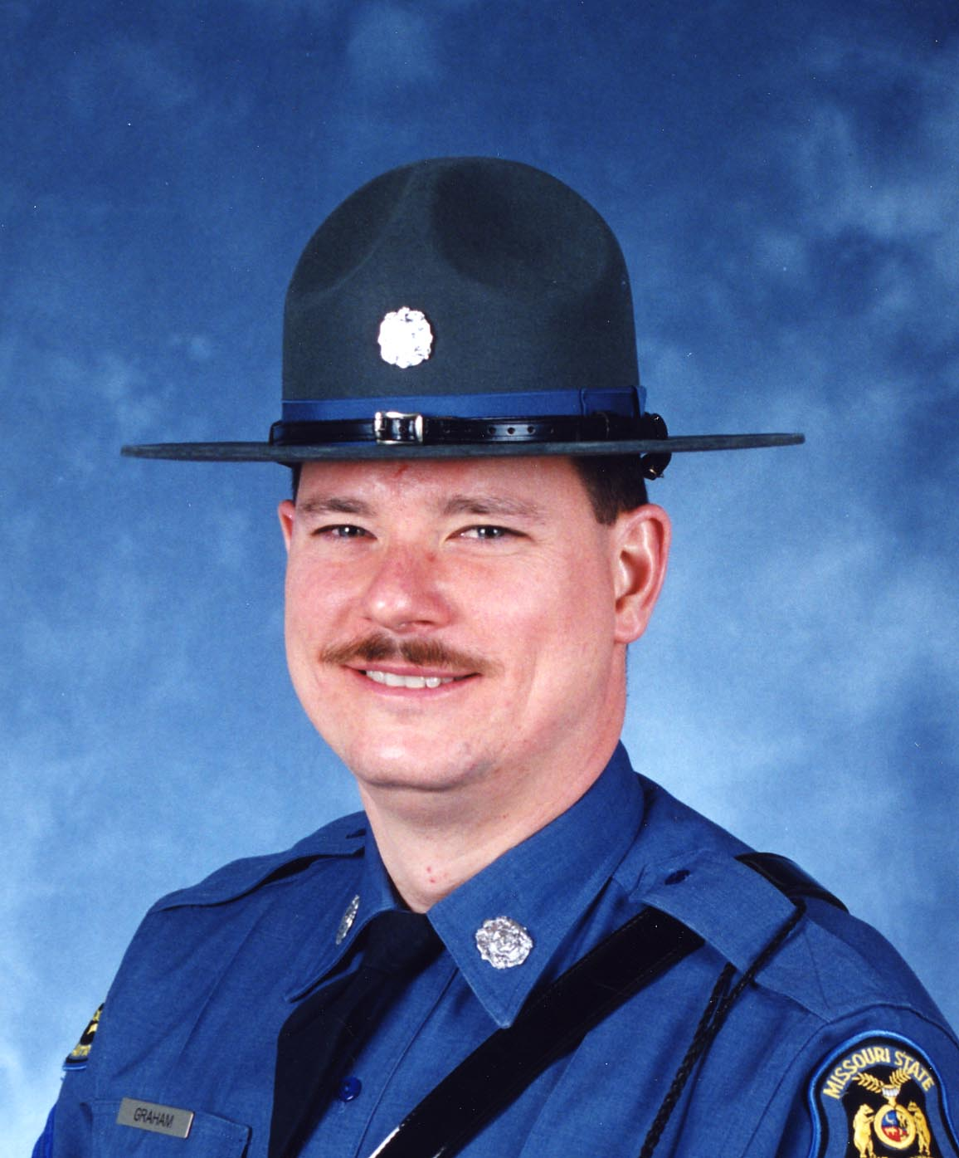
MSHP Sgt. Carl “Dewayne” Graham, Jr. Badge #223

Slide 38
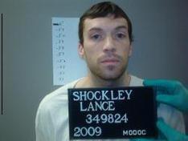

Slide 39
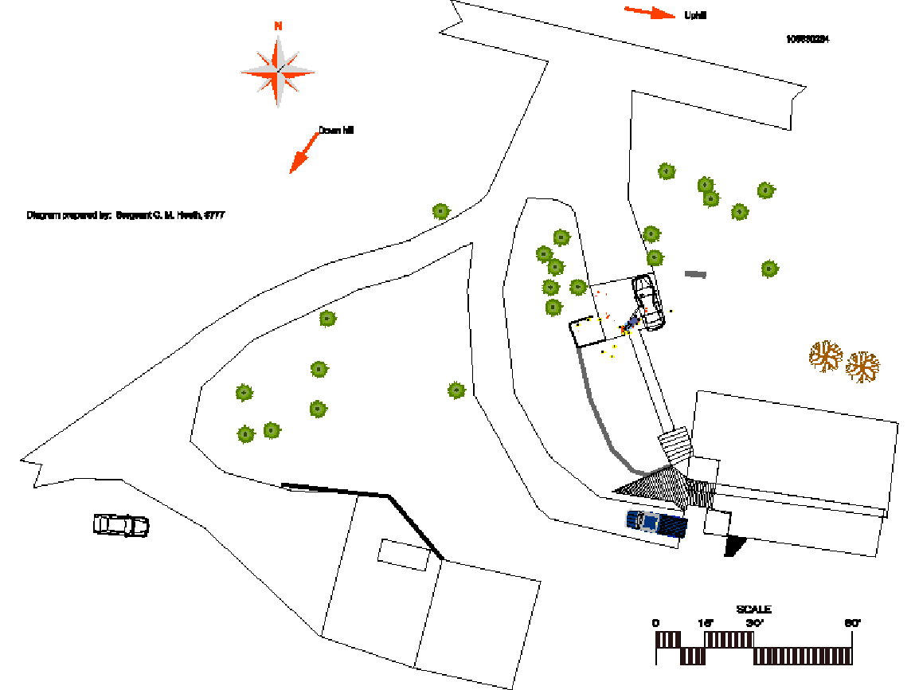

Slide 40
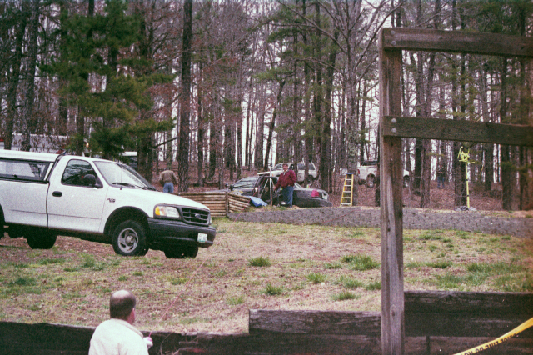

Slide 41
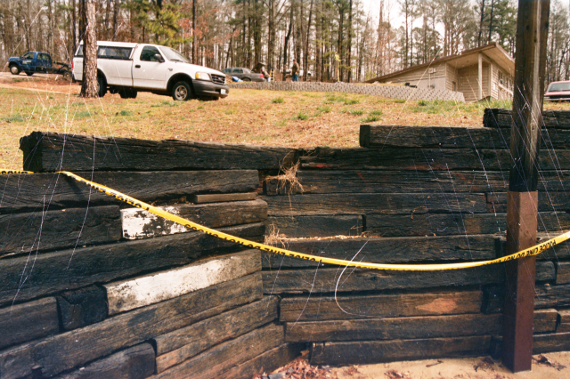

Slide 42
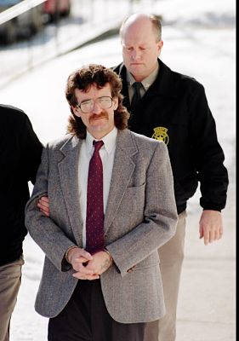
Dennis Skillicorn
Born 1959
1979 – Accomplice to prior murder–robbery
Sentenced to 35 yrs
Met Allen Nicklasson at halfway house while on parole

Slide 43
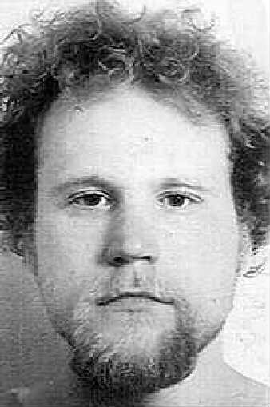
Allen Nicklasson
Born 1972
Placed in boys homes as a child--no consistent diagnosis, but often found to have a conduct disorder
1990 – Assaulted step-father; and sentenced to prison
1993 – Convicted of assault on a correctional officer while in prison
"he killed his father, attempted to kill his step-father, and is presently serving time for the assault of a correctional officer. Unfortunately for the citizens of this State, his maximum release date is…in 1993.... [T]his man without a doubt will kill someone when released.” The Warden.

Slide 44
Crime spree
Left halfway house to go to St. Louis to purchase Drugs
Car broke down on highway
Burglary of residence where guns stolen
Kidnaping/Carjacking of Richard Drummond, an AT&T Lineman
Murder of Drummond in rural Mo. County off I-70
Held guns on teens in suburban KC
Murder of Joseph and Charlene Babcock near Kingman, Arizona
Attempted robbery/shooting in parking lot in Huntington Beach, California

Slide 45
Crime spree
Trip to St. Louis to purchase Drugs
Burglary of residence where guns stolen
Kidnaping/Carjacking of Richard Drummond, an AT&T Lineman
Murder of Drummond in rural Mo. County off
I-70
Held guns on teens in suburban KC
Toasted themselves over a pitcher of beer
Left in victim’s car committing crimes along the way
“We did what we had to do to get along”

Slide 46
Crime spree
Got stuck in sand dune in desert near Kingman, AZ
Murder of Joseph and Charlene Babcock
Stole their truck
Attempted robbery/shooting in parking lot in Huntington Beach, California
Sent postcards to a girl they met near KC
Listed on America’s Most Wanted TV show
Arrested hitchhiking near San Diego
Prosecuted in Missouri in 1996

Slide 47
Evidence
1. Witnesses placed the 3 and their car in the area (near the equipment that Drummond would have been checking on)
2. Shell casings from the Drummond murder and the Babcock murders matched casings the residence where guns were stolen.
3. Witness confirmed Skillicorn had same type of gun the evening after the murder
4. Defendants made incriminating statements

Slide 48
Victim Impact Evidence
Just as the defendant is entitled to present evidence in mitigation designed to show that the defendant is a "uniquely individual human being," the State is also allowed to present evidence showing each victim's "uniqueness as an individual human being."

Slide 49
Please Remember
• When you value our right to live in peace in our homes, neighborhoods and communities, you value victims’ rights
• When you value our children and their hopes for a life of opportunity that is free from violence, you value victims’ rights
• When you value justice for all people who live in America, you value victims’ rights

Slide 50
2pac- 16 On Death Row

